Slide 1
Welcome To Our Project Presentation

Slide 2
Presented By
Name
Ahsan Habib
Jihad
ID
191002299
202002082
Course name : Data Communication Lab
Course ID : CSE 308
Section : 202 D1
Topic : File Transfer Protocol Using Cisco Packet Tracer

Slide 3
CONTENTS TO BE DISCUSSED
Introduction to FTP in Cisco Packet Tracer
Configure FTP Services on Servers
Upload a File to the FTP Server
Download a File From the FTP Server
Pros & Cons of FTP
Applications of File Transfer Protocol

Slide 4
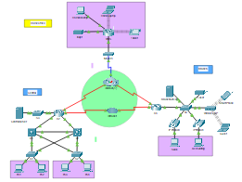
Introduction to FTP in Cisco Packet Tracer
In this Project, we will configure FTP services. We will then use the FTP services to transfer files between clients and the server.

Slide 5
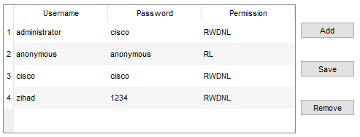
Configure FTP Services on Servers
Configure the FTP service on Central Server
a. Click Central Server > Services tab > FTP.
b. Click On to enable FTP service.
c. In User Setup, create the following user accounts. Click Add to add the account:

Slide 6
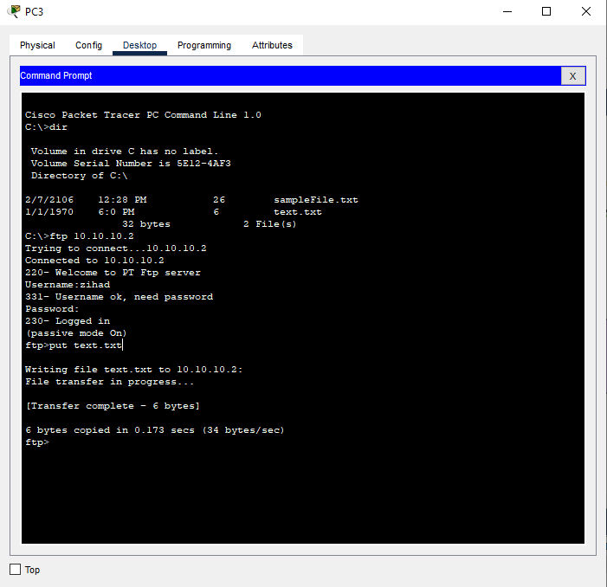
Upload a File to the FTP Server

Slide 7
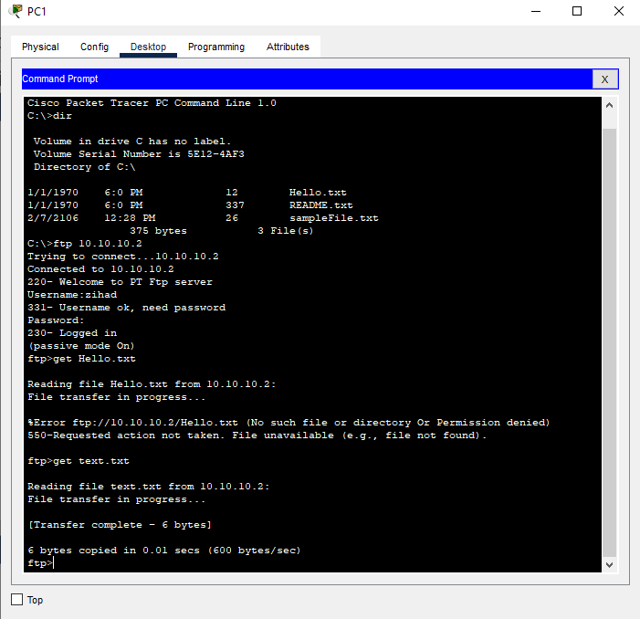
Download a File From the FTP Server

Slide 8
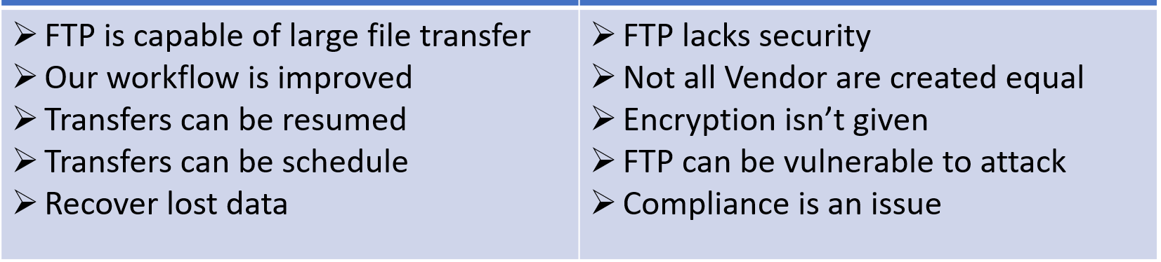
Advantages and disadvantages of FTP
Advantages
Disadvantages

Slide 9
Applications of File Transfer Protocol
Civil Engineering, Architecture and Construction
Transcription services and printing
IT consulting
Business consulting
Financial services
Legal services
Media & marketing

Slide 10
Thanks!
Any questions ?

